Slide 1
Designing a 32-bit Multiplier using transistor level Digital Gates simulated in SPICE
A presentation on Academic Internship done during summer break 2020

Slide 2
Group Members
Pankaj Kumar Sah
Mrinab Dey
Souvik Das
Gaurab Paul
Dip Jyoti Dutta

Slide 3
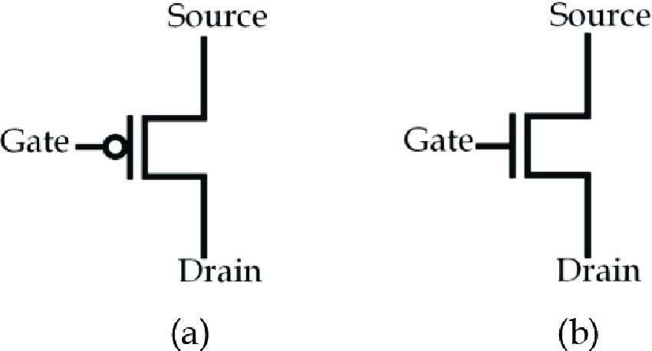
Transistors and CMOS tech
MOSFET
(a) PMOS
(b) NMOS
CMOS
( Complementary Metal Oxide Semiconductor )

Slide 4
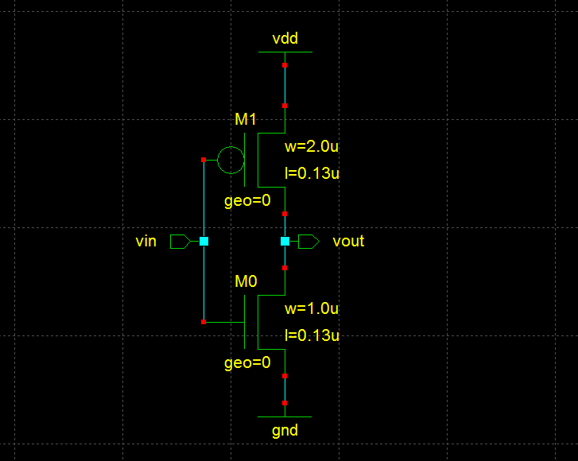
Gates made using CMOS
When used vin = 1
M1 is Off
M0 is On
i.e., vout = 0
When used vin = 0
M1 is On
M0is Off
i.e., vout = 1
So, the gate is NOT gate

Slide 5
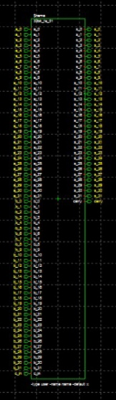
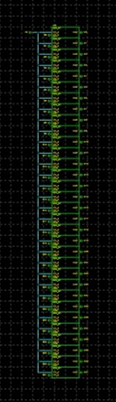
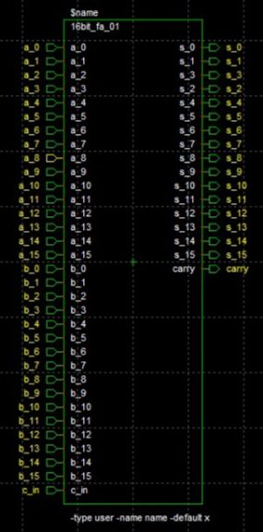
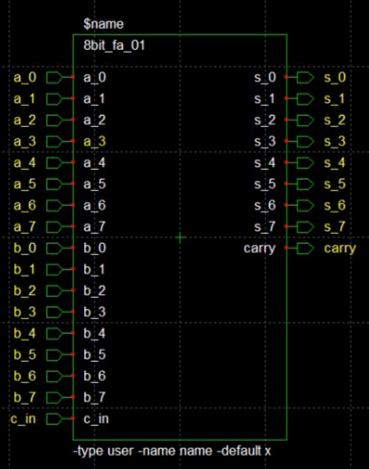
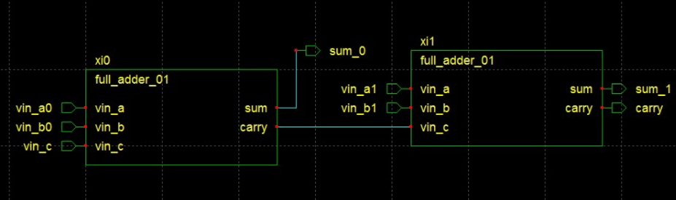
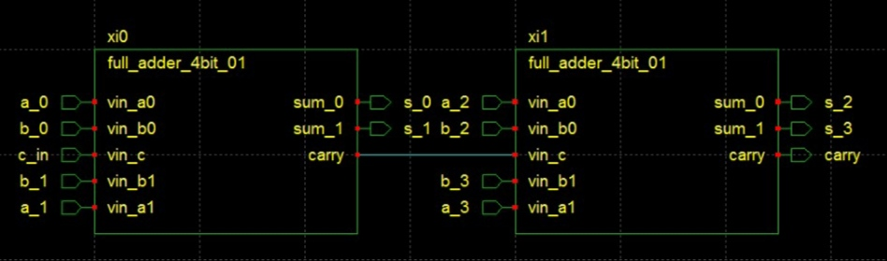
Combinational Circuits Used
Full Adder
32×1 AND Circuit
A₃₁A₃₀A₂₉………..A₆A₅A₄A₃A₂A₁A₀
+ B₃₁B₃₀B₂₉…………B₆B₅B₄B₃B₂B₁B₀
__________________________
Z₃₁Z₃₀Z₂₉………….Z₆Z₅Z₄Z₃Z₂Z₁Z₀
A₃₁A₃₀A₂₉A₂₈A₂₇…………..A₇A₆A₅A₄A₃A₂A₁A₀
× B₀
___________________________________
Z₃₁Z₃₀Z₂₉Z₂₈Z₂₇……………….Z₇Z₆Z₅Z₄Z₃Z₂Z₁Z₀

Slide 6
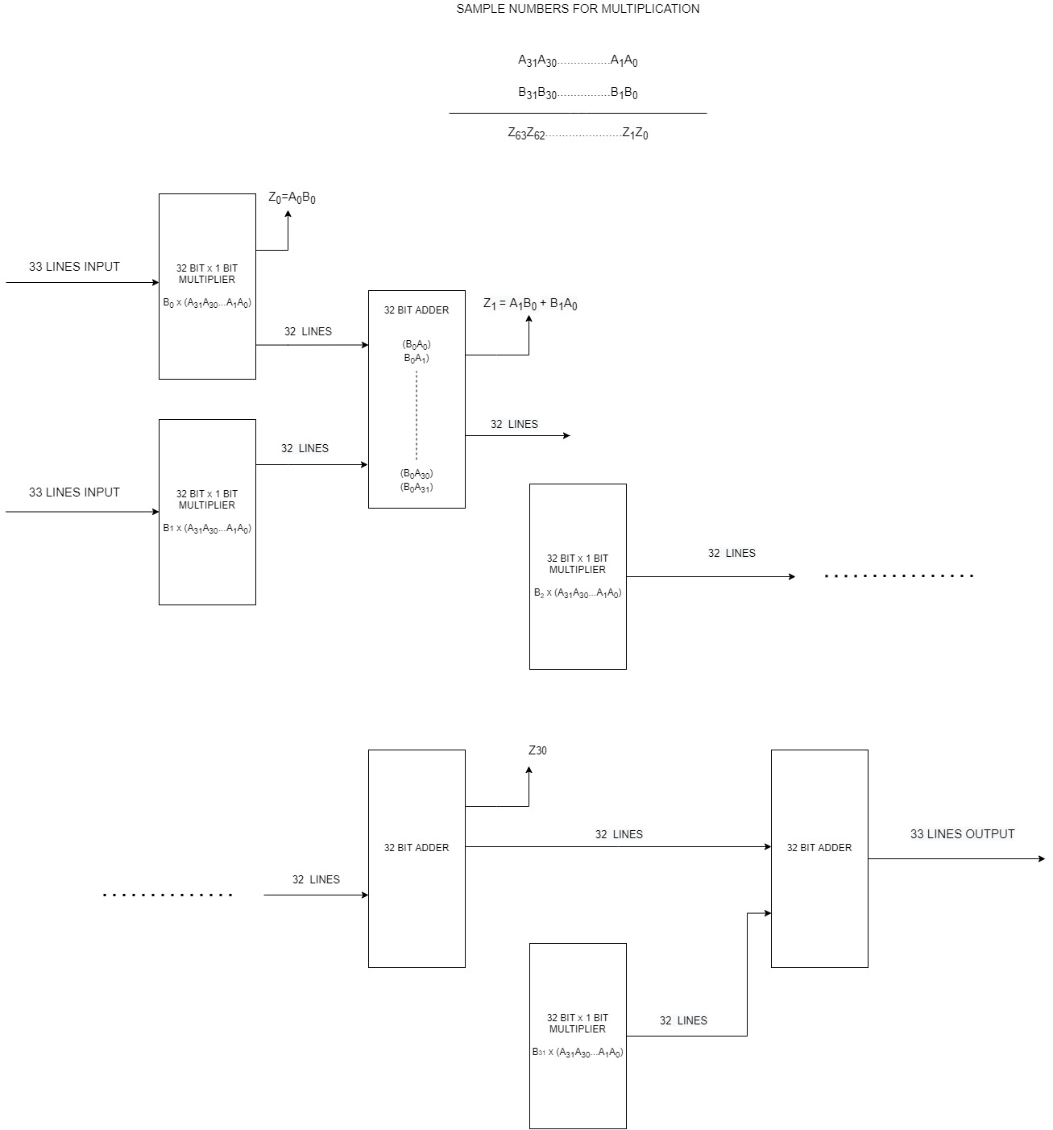
Multiplier Operation
A₃₁A₃₀A₂₉A₂₈……………A₅A₄A₃A₂A₁A₀
× B₃₁B₃₀B₂₉B₂₈……………B₅B₄B₃B₂B₁B₀
___________________________
Z₀₃₁Z₀₃₀Z₀₂₉……………Z₀₅Z₀₄Z₀₃Z₀₂Z₀₁Z₀₀
Z₁₃₁Z₁₃₀Z₁₂₉…………..Z₁₅Z₁₄Z₁₃Z₁₂Z₁₁Z₁₀×
.
.
.
.________________________
FINAL OUTPUT

Slide 7
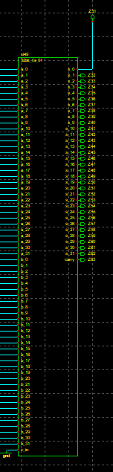
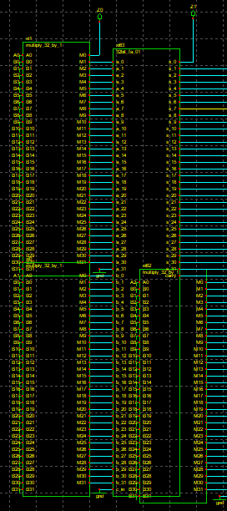
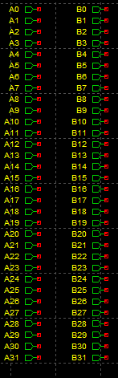
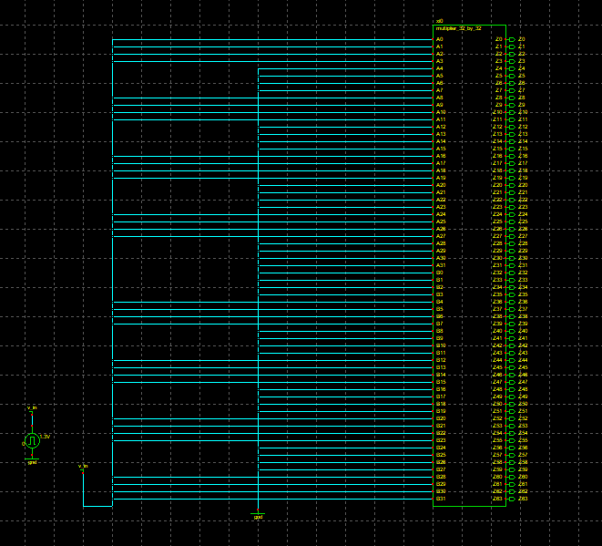
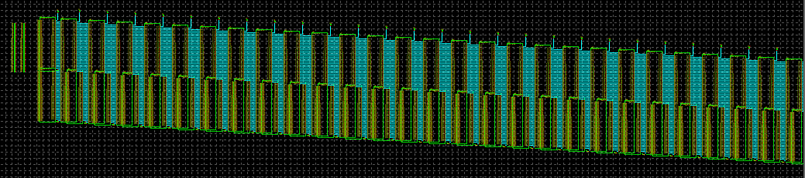
Schematics
32bit multiplier
Test Bench

Slide 8
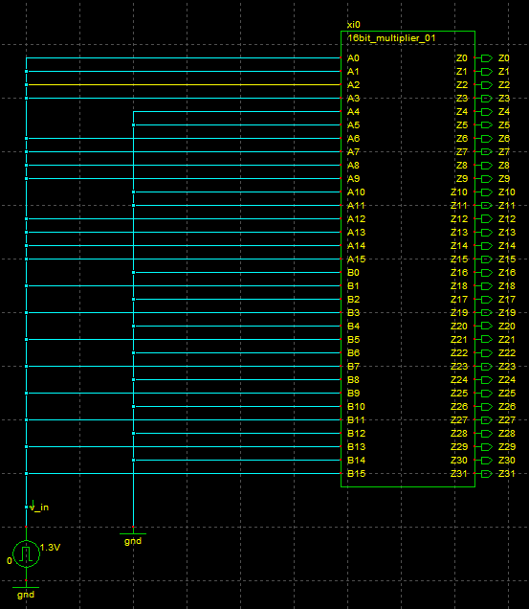
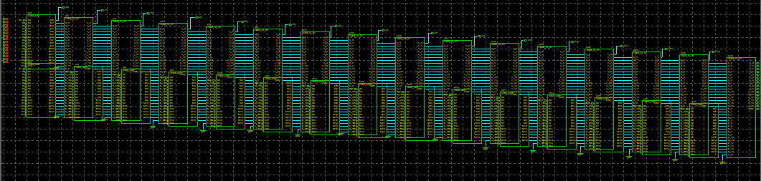
Problems faced
32-bit multiplier didn’t work
We tested on 16bit version

Slide 9
Inputs Used
Input 1: 1111001111001111
62415 ( decimal form )
Input 2: 1010101010101010
43690 ( decimal form )
Output: 10100010100010010101110101110110
2726911350 ( decimal form )

Slide 10
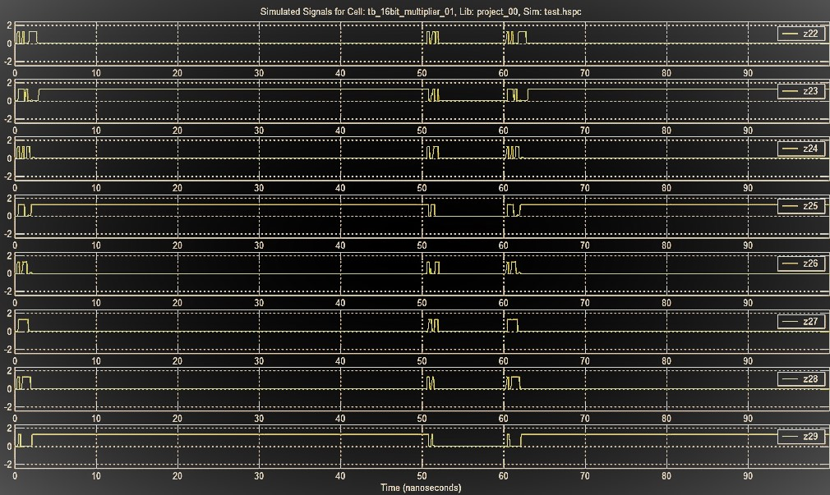
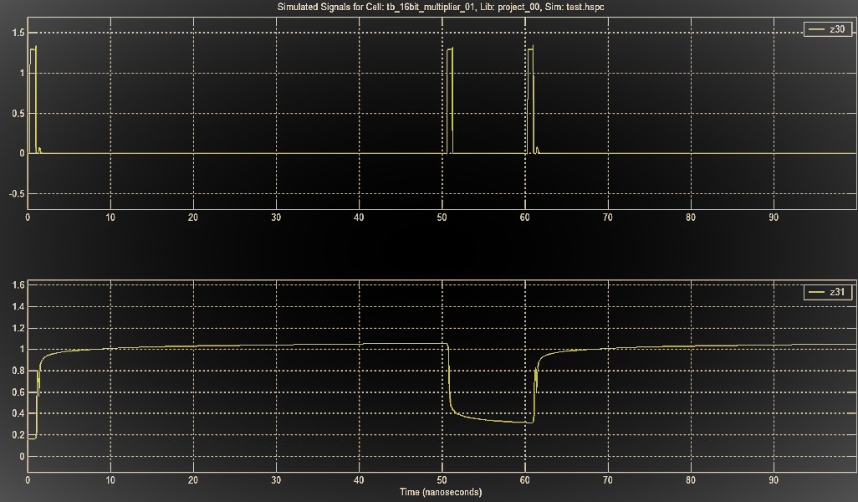
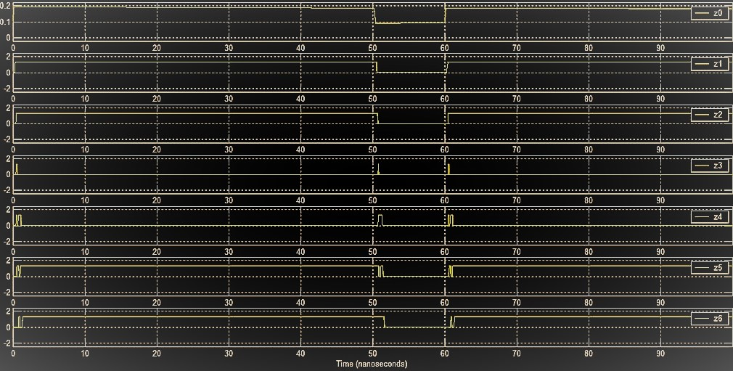
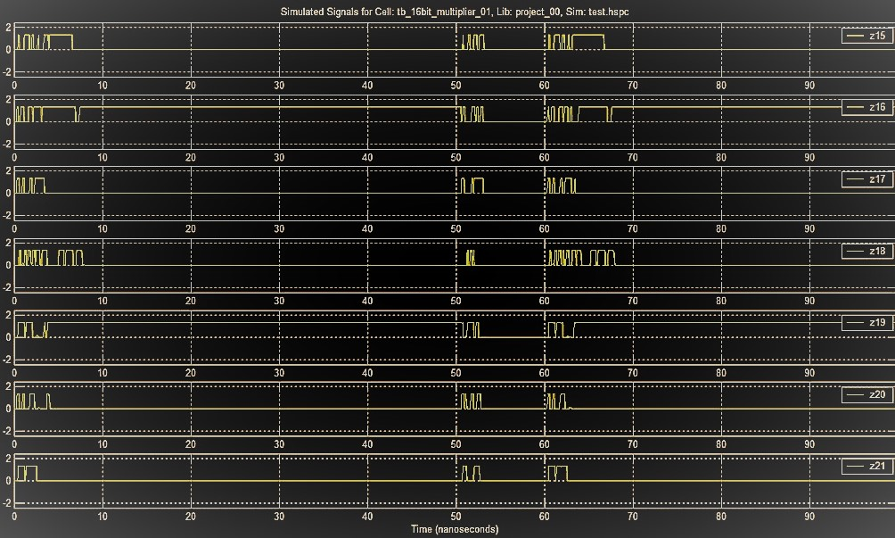
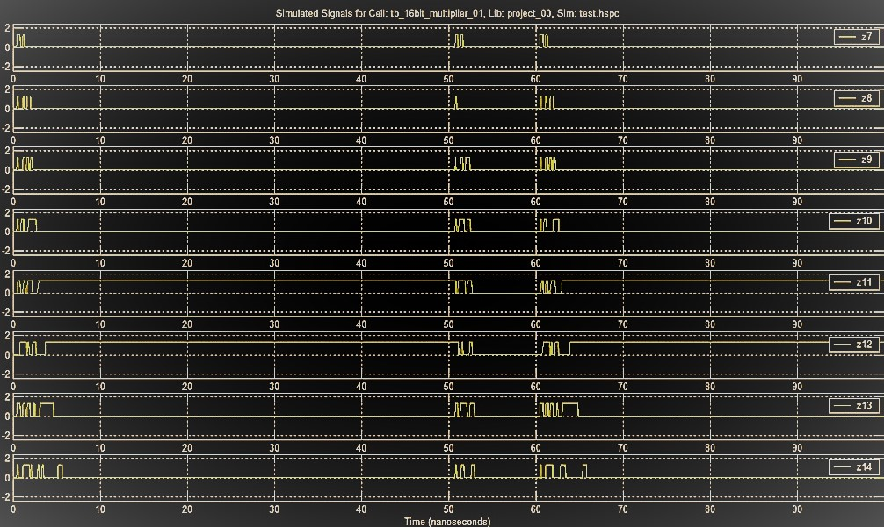
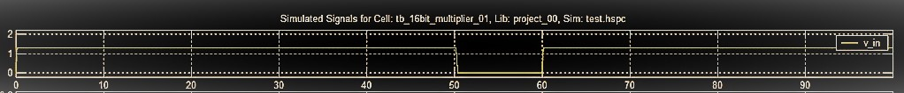
Outputs we got

Slide 11


Platform Used
CppSim

Slide 12
Conclusion
Unable to run 32bit version
16bit version gave the correct output
Insights of VLSI industry

Slide 13
Thank You!

